Slide 1

Telecom Customer Churn Prediction
Presented by Nour Kamaly

Slide 2
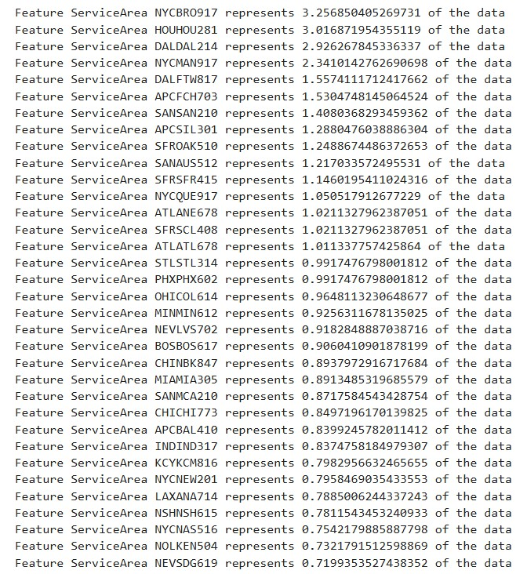
Potential Data problems
Null values
High dimensionality (57 features)
High cardinality features (service area has 747 unique values)
‘Unknown’ values in marital status and handset price
Label imbalance
Maybe unrepresentative features ?

Slide 3
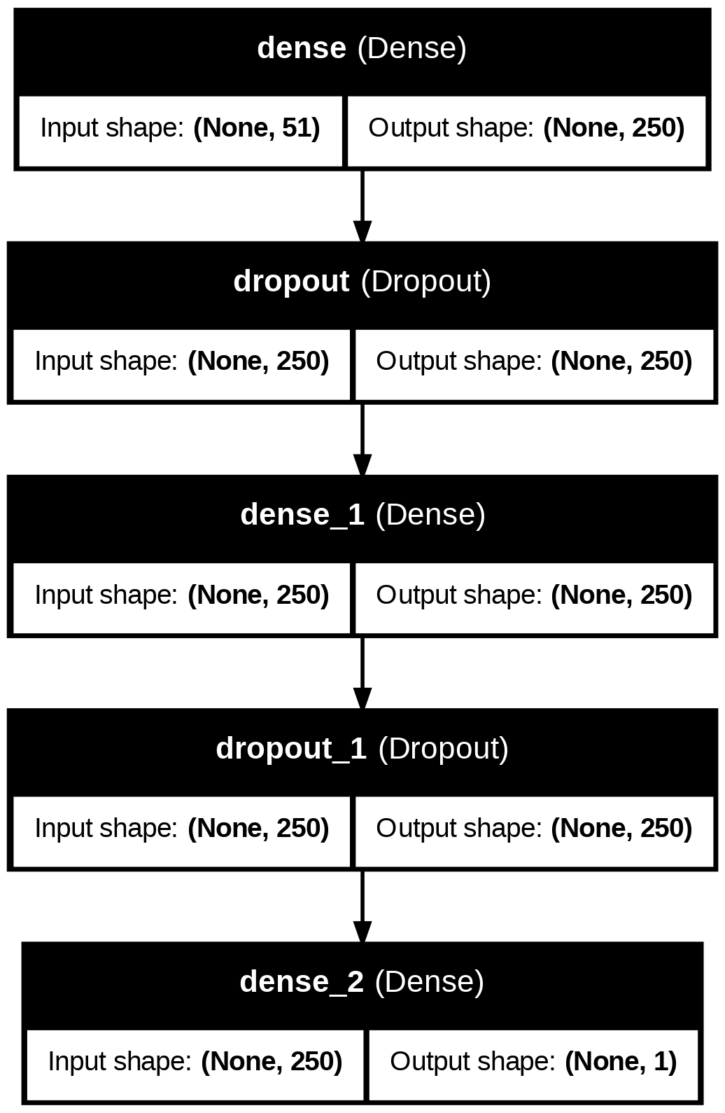
State of the art results
Customer churn prediction in telecommunication industry using deep learning. (2022). Information Sciences Letters, 11(1), 185–198. https://doi.org/10.18576/isl/110120
Preprocessing: label encoding, one hot encoding, normalization, resampling
Feature selection: lasso regression
Machine Learning Models used:
XGBoost
KNN Linear Regression
Naïve Bayes
Method implemented in the paper: fully connected neural network
Results:
Accuracy = 79.38%,
Precision = 74.50%,
Recall = 89.32%,
F1-score = 81.24%
AUC = 79.38%

Slide 4
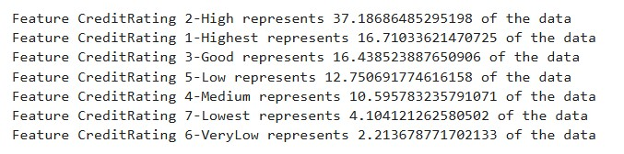
Preprocessing pipeline
Selecting highly present features values in features
Data splitting
Converting unknowns into nulls
Label/One Hot encoding
Feature extraction
Feature selection & sampling
Imputing nulls
NYCWHI914
New York
State
Westchester County
914 area code
Notes:
Pre-Modeling: Data Preprocessing and Feature Exploration in Python

Slide 5
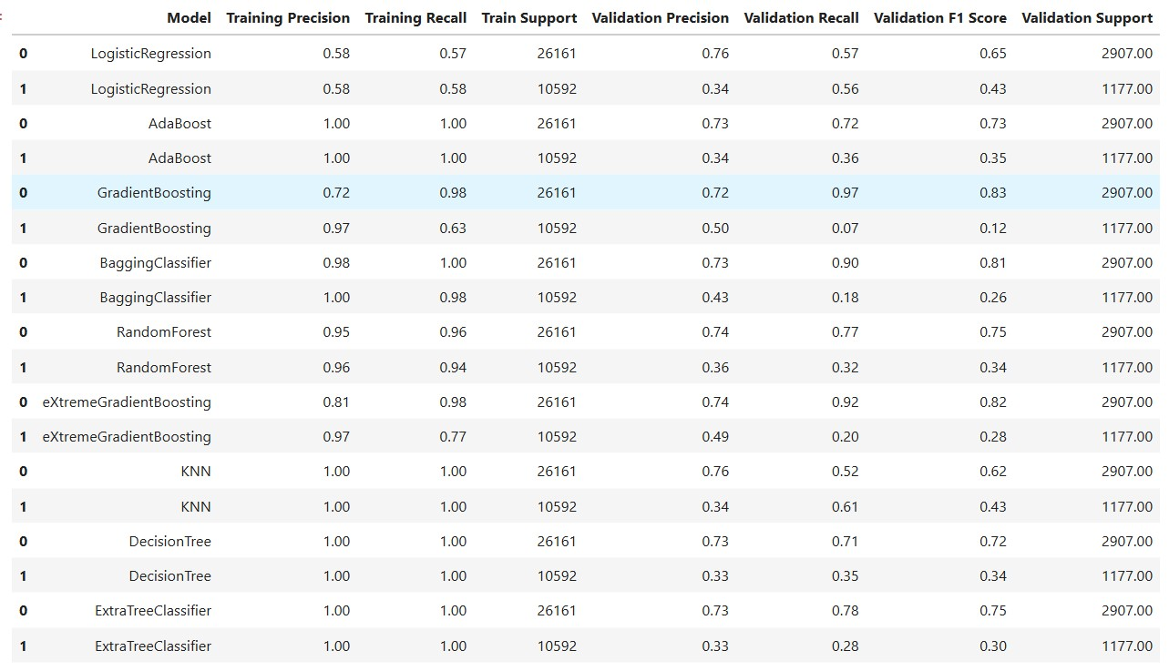
Experiments - SMOTE

Slide 6
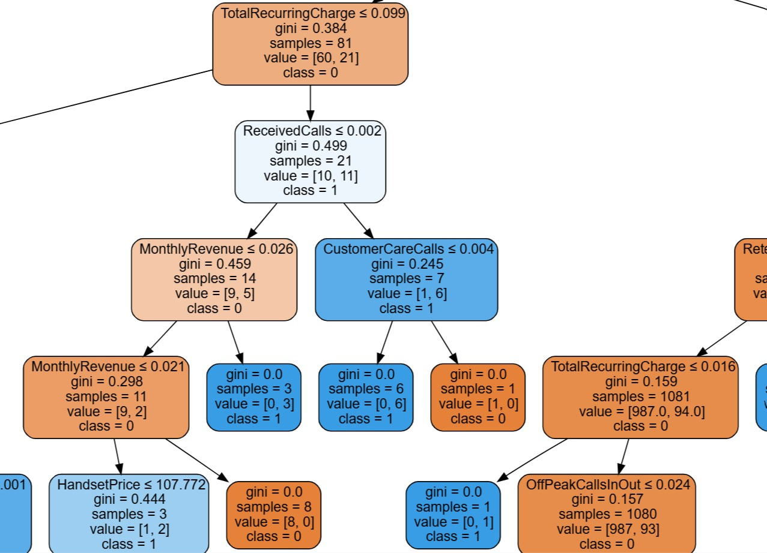
Experiments – Error Analysis & explainability

Slide 7

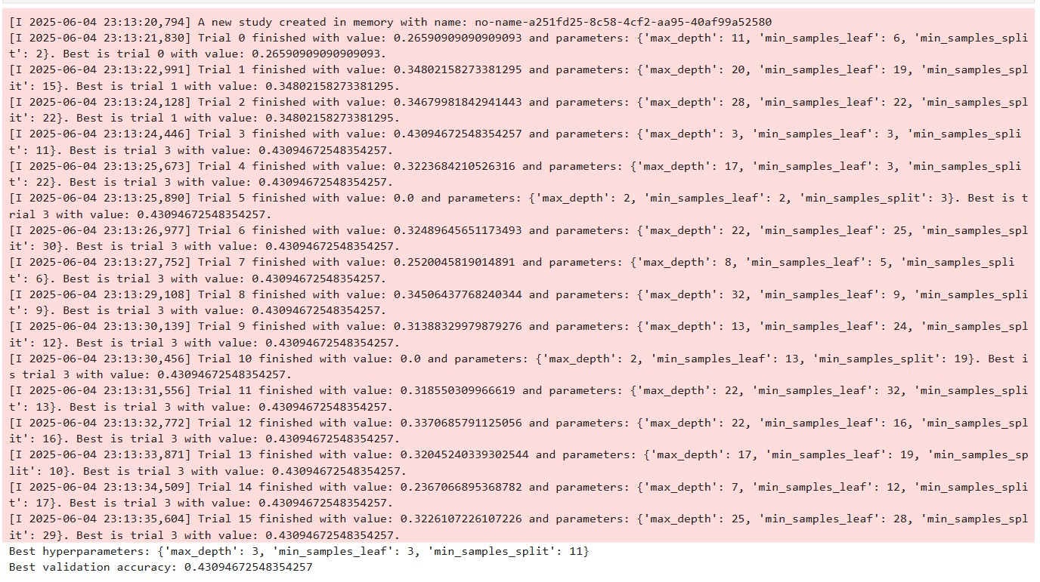
Optimizing decision tree parameters

Slide 8
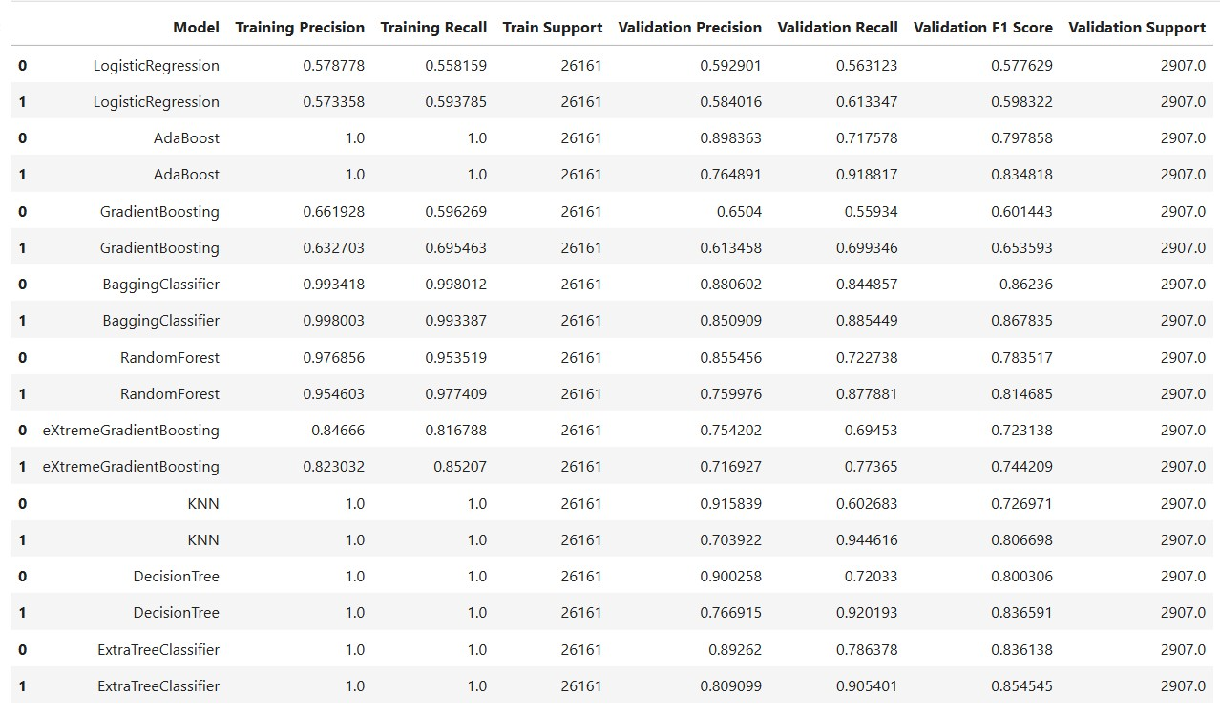
Experiments – Random Over Sampling

Slide 9
Experiments – Random over sampling
Label/ Metric | Precision | Recall | F1 Score
0 | 0.60 | 0.69 | 0.64
1 | 0.63 | 0.54 | 0.58

Slide 10
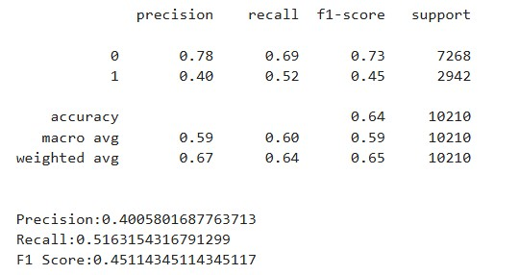
Blind test data

Slide 11
Next steps
Explore features in the IBM telco dataset (precision > 90% for yes class)
Build a power BI report to further understand the data
Convert model to ONNX
Package testing script into a docker container

Slide 12

Thank You!
nourkamaly26@gmail.com

